Slide 1
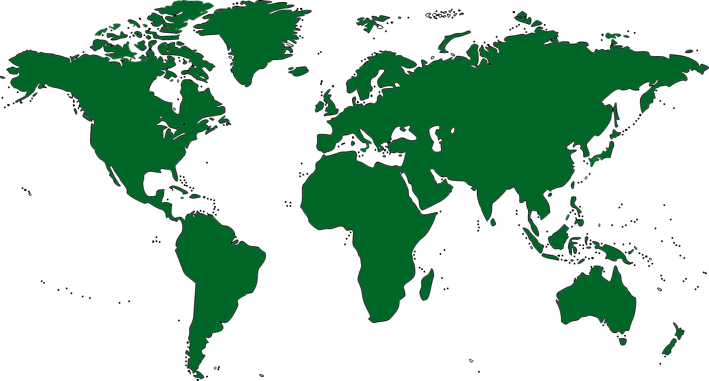

24.4C
ANCHORAGE
24.4C
24.4C
VANCOUVER
24.4C
24.4C
MOSCOW
LONDON
BERLIN
24.4C
24.4C
24.4C
24.4C
24.4C
24.4C
SEOUL
24.4C
LOS ANGELES
CHICAGO
NEW YORK
PARIS
DUBAI
24.4C
TOKYO
24.4C
BEIJING
24.4C
14.4°C
CAIRO
HONG KONG
MEXICO CITY
24.4C
24.4C
24.4C
NAIROBI
24.4C
LIMA
RIO DE JANEIRO
SINGAPORE
24.4C
24.4C
SYDNEY
24.4C
CAPE TOWN
24.4C
BUENOS AIRES
PERTH
24.4C

Slide 2
14.4°C
ANCHORAGE
14.4°C
14.4°C
VANCOUVER
14.4°C
14.4°C
MOSCOW
LONDON
BERLIN
14.4°C
14.4°C
14.4°C
14.4°C
14.4°C
14.4°C
SEOUL
14.4°C
LOS ANGELES
CHICAGO
NEW YORK
PARIS
DUBAI
14.4°C
TOKYO
14.4°C
BEIJING
14.4°C
14.4°C
CAIRO
HONG KONG
MEXICO CITY
14.4°C
14.4°C
14.4°C
NAIROBI
14.4°C
LIMA
RIO DE JANEIRO
SINGAPORE
14.4°C
14.4°C
SYDNEY
14.4°C
CAPE TOWN
14.4°C
BUENOS AIRES
PERTH
24.4°C

Slide 3
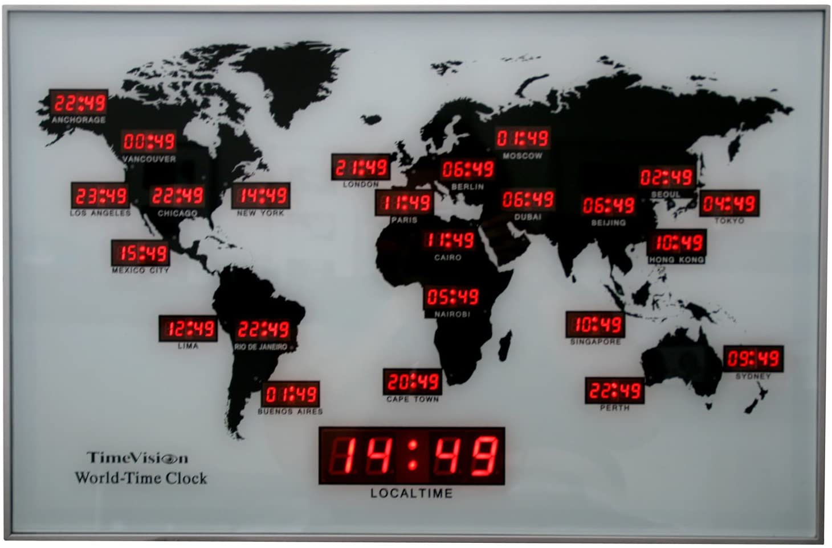

Slide 4
